Slide 1
Advanced Deep Learning ZG513
Dr. Sugata Ghosal
sugata.ghosal@pilani.bits-pilani.ac.in

Slide 2
Agenda
Supervised vs Unsupervised Learning Experience
Autoencoders
Undercomplete AE
Regularized AE
Convolutional AE
Denoising AE
Sparse AE
Deep Autoencoders

Slide 3




In This Segment
Supervised vs Unsupervised Learning Experience Autoencoders
Undercomplete Autoencoders Regularized Autoencoders Convolutional Autoencoders Denoising Autoencoders Sparse Autoencoders
Deep Autoencoders
1
2
3
4
5
6
7
8

Slide 4

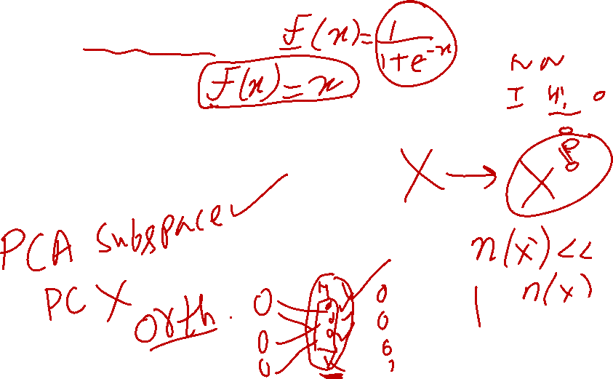
Autoencoders and PCA
The encoder of a linear autoencoder is equivalent to PCA if we
⁾ use a linear encoder
⁾ use a linear decoder
⁾ use a squared error loss function
⁾ normalize the inputs to

Slide 5



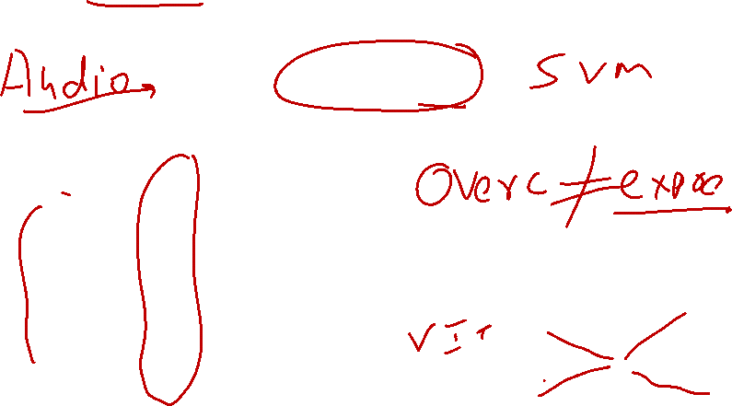
Overcomplete Autoencoders
One hidden layer which has more units than input layer.
dim(h) ≥ dim(x )
Learn a trivial encoding by simply copying x_{i} into h and then copying h into x^{ˆ}_{i} .
Hidden
Encoder Decoder
_{h}
1
x₁
h₂
xˆ₁
x₂
h₃
xˆ₂
h = g(W_{e}x_{i} + b) x^{ˆ}_{i} = f (W_{d} h + c)
x₃
h₄
xˆ₃
x₄
h₅
xˆ₄
h₆

Slide 6
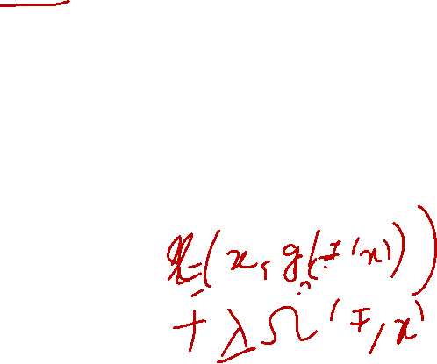
Regularized Autoencoders
Autoencoders fail to learn anything useful if the
⁾ the encoder and decoder are given too much capacity.
⁾ the hidden code is allowed to have dimension equal to the input.
⁾ the hidden code has dimension greater than the input. (overcomplete case)
Use Regularized autoencoders to resolve the above problems. To avoid poor generalization, introduce regularization.
Introduces properties
⁾ sparsity of the representation
⁾ smallness of the derivative of the representation
⁾ robustness to noise or to missing inputs.

Slide 7
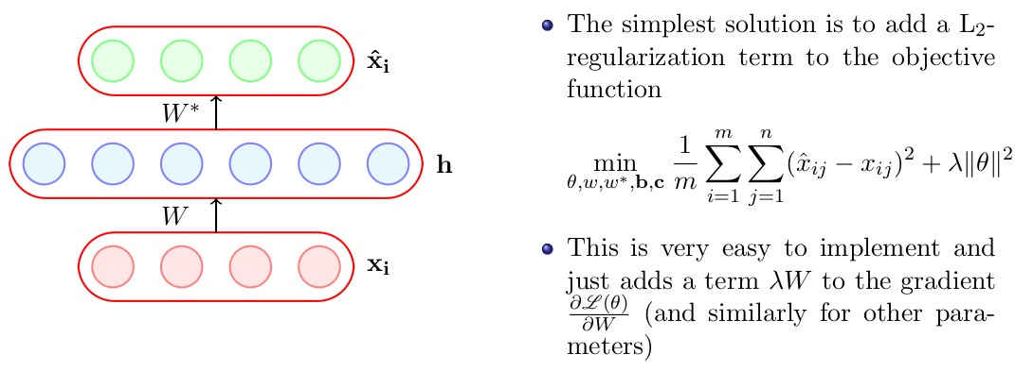


Slide 8
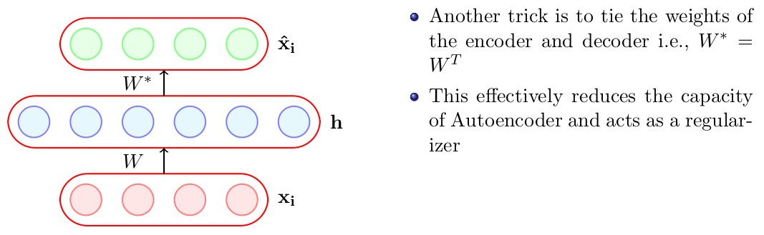

Slide 9
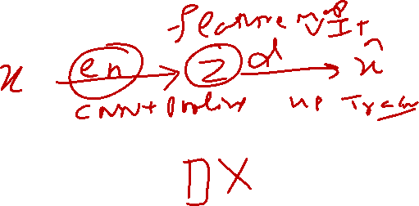
Convolutional Autoencoders
Allows us to increase the size of the output feature map compared to the input feature map.
Fractionally strided convolution is another term.
Strides In transposed convolutions, we stride over the output; hence, larger strides will result in larger outputs (opposite to regular convolutions).

Slide 10
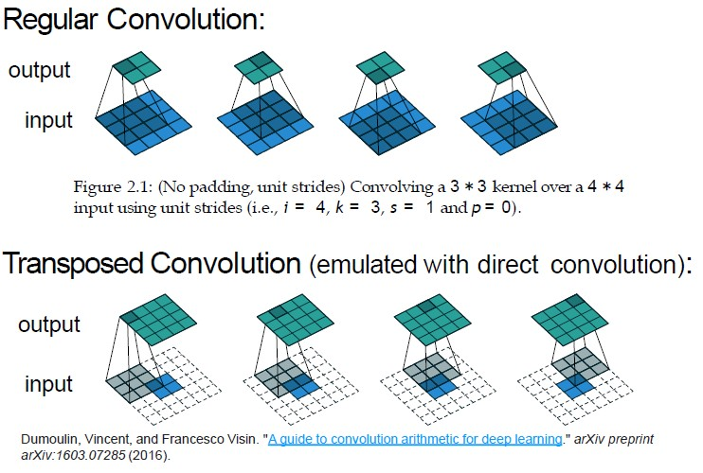
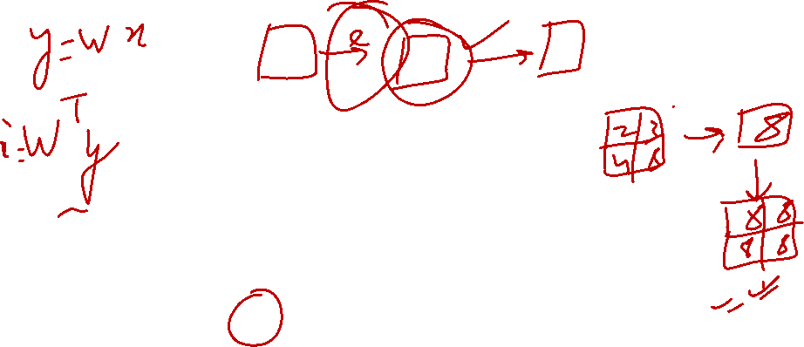
Convolutional Autoencoders

Slide 11
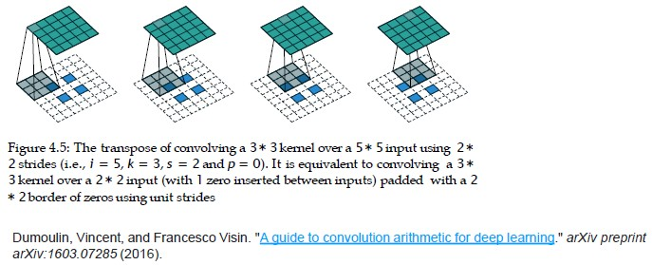
Convolutional Autoencoders

Slide 12
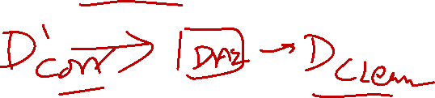
Denoising Autoencoders (DAE)
Receives a corrupted data point as input and is trained to predict the original, uncorrupted data point as its output.
x˜ is a copy of x corrupted by some form of noise.
The corruption process adds some noise to x according to the conditional distribution C(x˜, x ).
Denoising autoencoders removes this corruption.

Slide 13
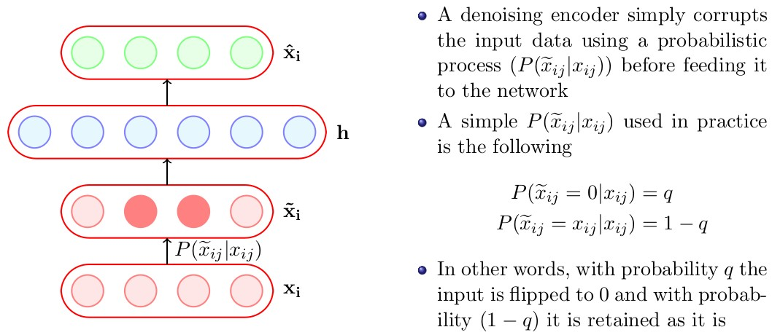
Denoising Autoencoder

Slide 14
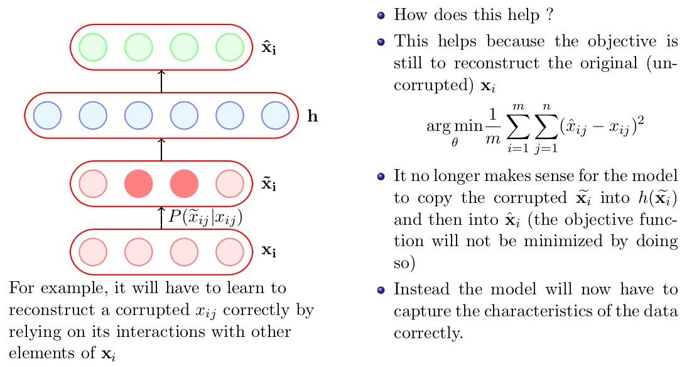
Denoising Autoencoder

Slide 15
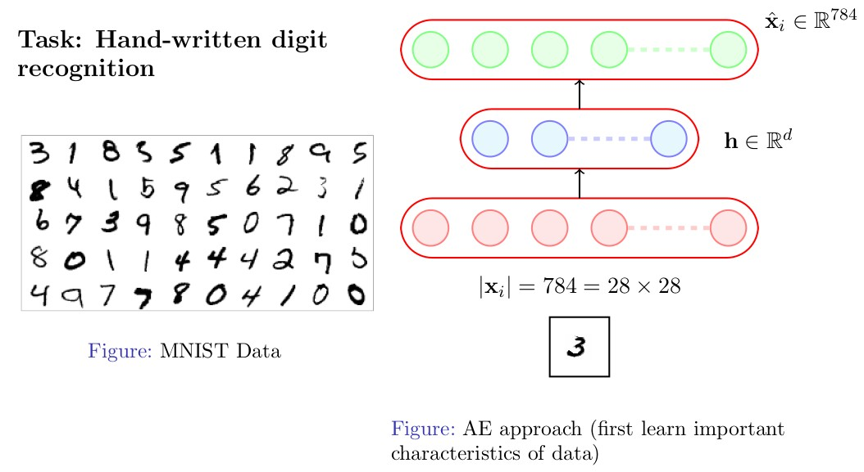
Denoising Autoencoder

Slide 16
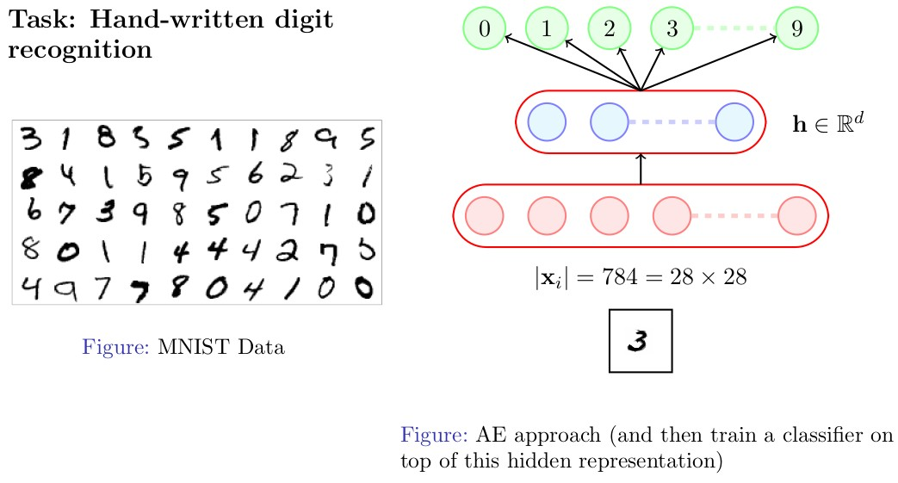
Denoising Autoencoder

Slide 17
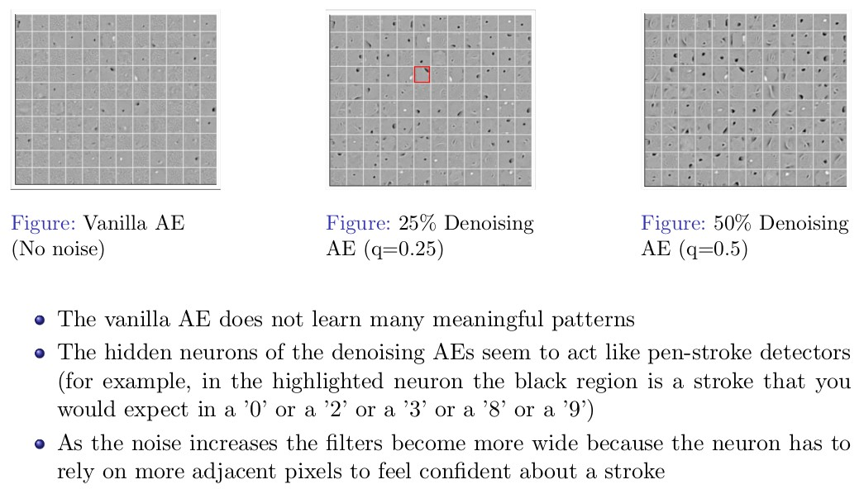
Denoising Autoencoder

Slide 18
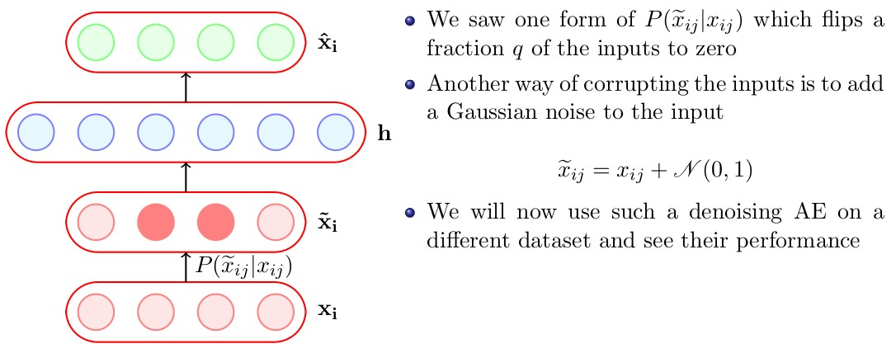
Denoising Autoencoder

Slide 19
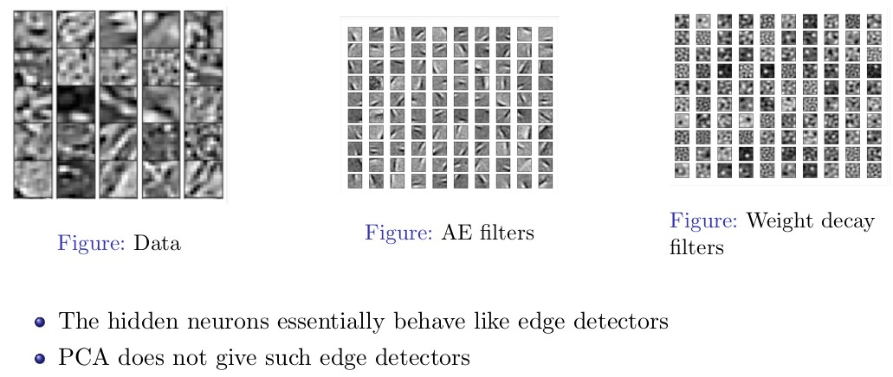
Denoising Autoencoder

Slide 20
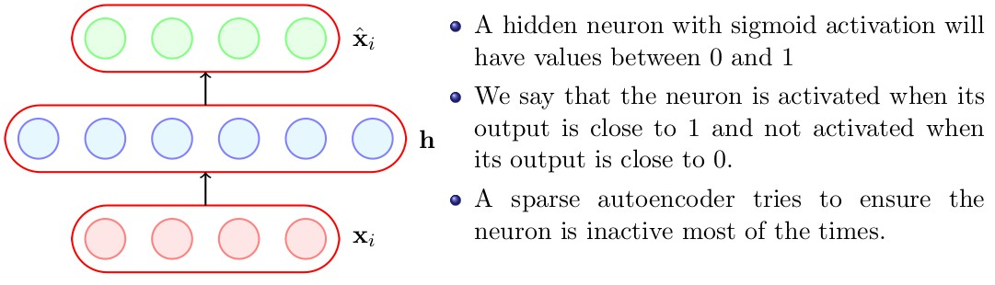
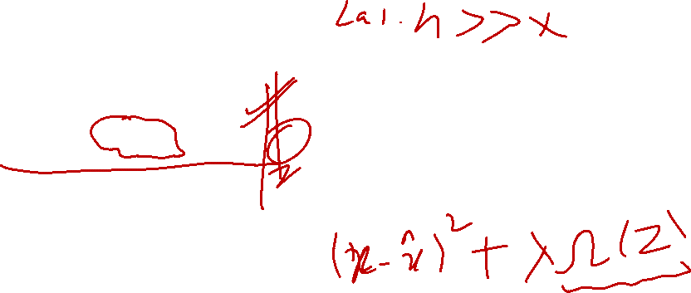
Sparse AE
Sparse Autoencoder

Slide 21
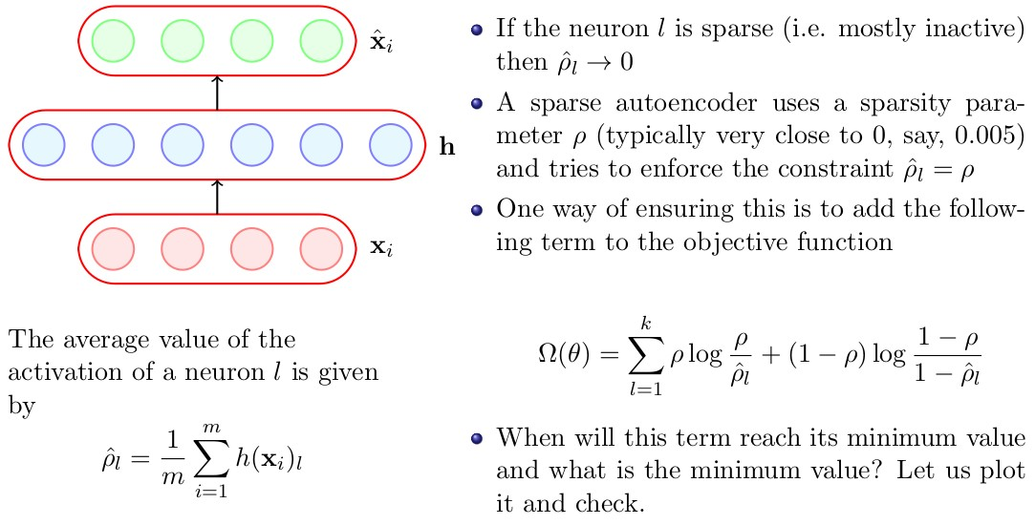
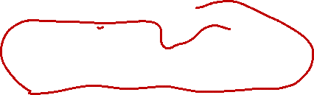
Sparse AE
Sparse Autoencoder

Slide 22
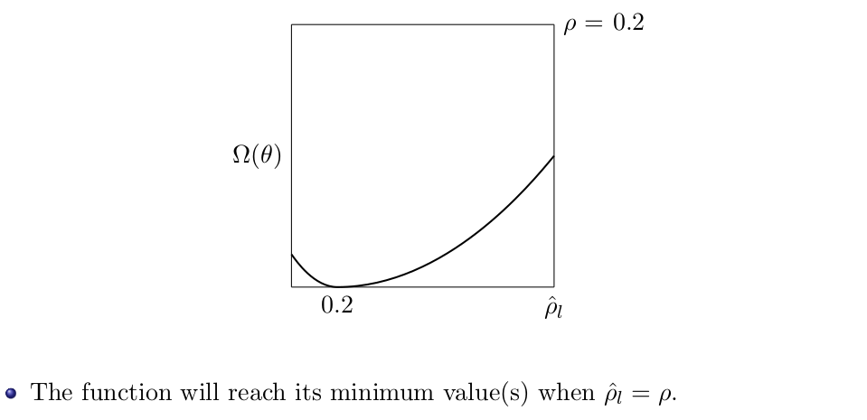
Loss Function
Sparse Autoencoder

Slide 23
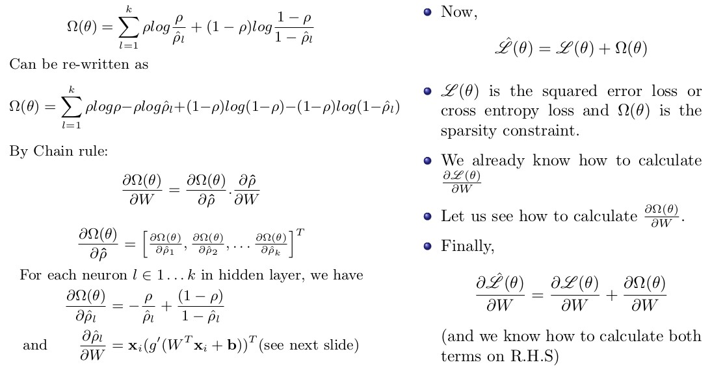
Sparse Autoencoder

Slide 24
References
1
Deep Learning by Ian Goodfellow, Yoshua Bengio, Aaron Courville
https://www.deeplearningbook.org/
2
Deep Learning with Python by Francois Chollet.
https://livebook.manning.com/book/deep-learning-with-python/

